Slide 1
Performance review of RCH indicators based on data of MatrtiMaa app
24th June, 2022
Meeting Hall, O/o the CMOH, North24Parganas

Slide 2
Performance as per State & District Report

Slide 3
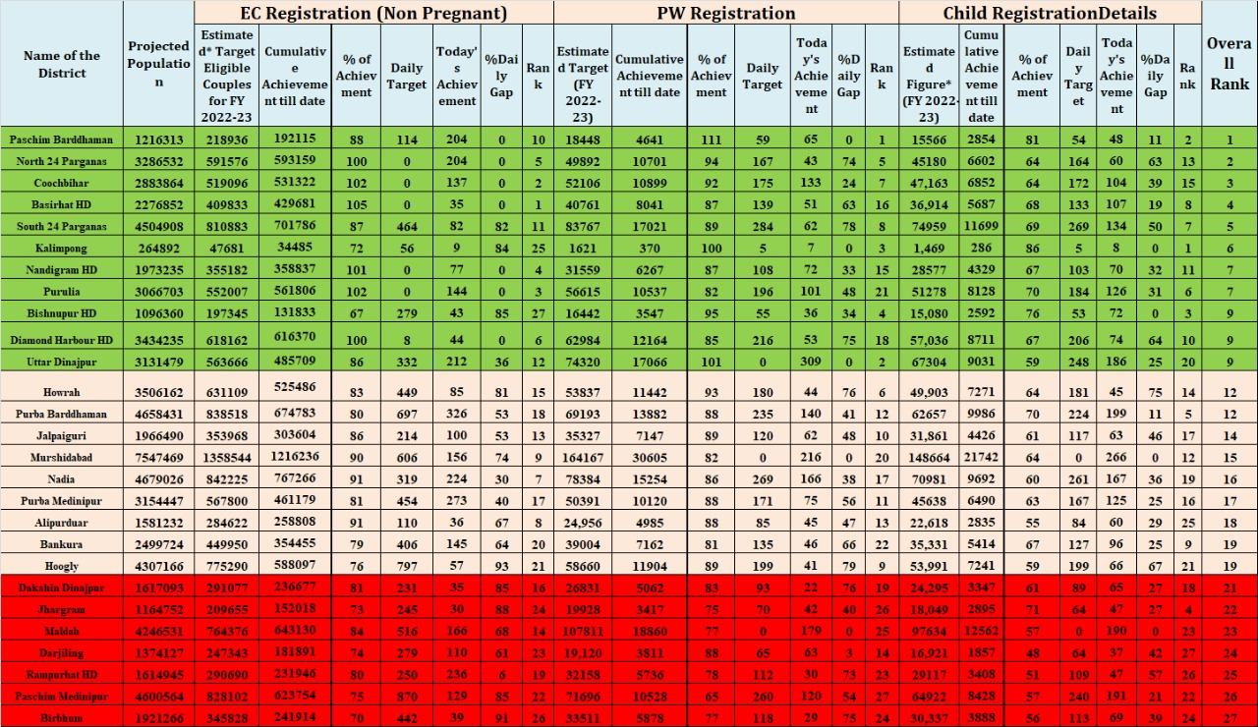

Slide 4
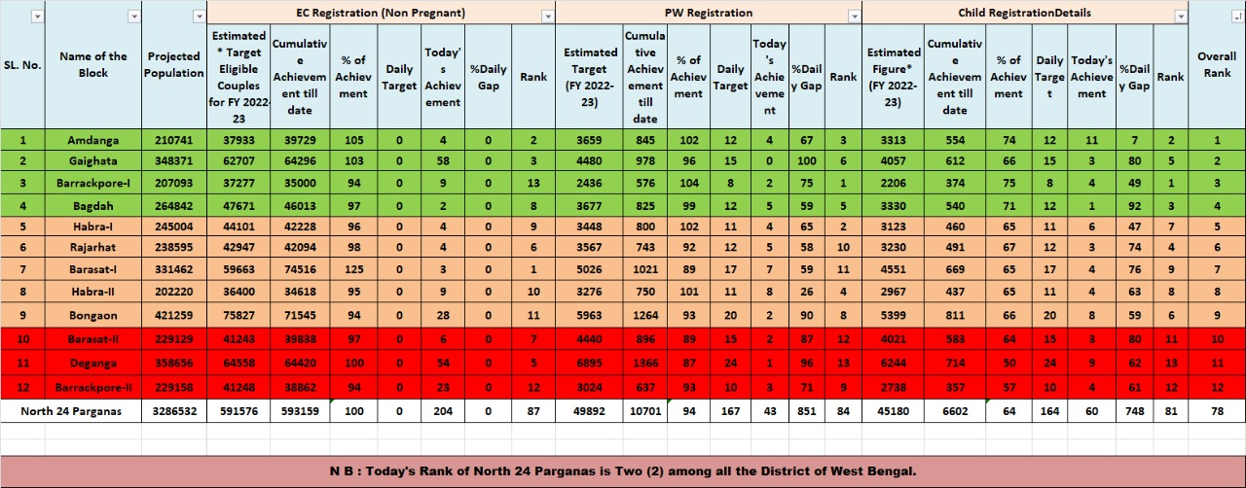

Slide 5
Eligible Couples & Family Planning

Slide 6
% of EC registration against ELA Period : 1st April to 21st June 2022
Data source:- Matrimaa Portal->Report->General->Beneficiary Registration Count Report (2022-2023)

Slide 7
% of FP method using against active EC Period : Current Cumulative
Data Source:-Matrimaa Portal->Report-> Family Planning -> FP Method Details

Slide 8
% of FP method using against active teenage EC
Period : Current cumulative
Data Source:-Matrimaa Portal->Report-> Family Planning -> FP Method Details

Slide 9
Pregnant Women Registration
&
Service Updation

Slide 10
% of Pregnant Women regd. against ELA
Period : 1st April to 22nd June 2022
Data Source:-Matrimaa Portal->Report->General->Beneficiary Registration Count Report

Slide 11
% of teenage PW against PW regd.
Period : LMP date 1st April 2022 – 20th June 2022
Data Source:-Matrimaa Portal->Report->Maternal Health-> Teenage Pregnancy Details Report

Slide 12
Early detection of Pregnancy: PW regd. Within 12 weeks(%)
Period : 1st April 2022 – 20th June 2022
Data Source:-Matrimaa Portal->Maternal Health->PW Registration Report

Slide 13
% of C-Section against delivery reported
Period : 01.04.2022 to 20.06.2022

Slide 14
Home delivery

Slide 15
% of At least 4 PNC done against delivery reported
Period : 1st April 2021- 31st March 2022
Data Source:-Matrimaa Portal->Report->Maternal Health-> Tracking Of Mother Services Report -> Tracking of PNC Service (2021-2022)

Slide 16
Children Registration
&
Service Updation

Slide 17
% of Infant Regd. against ELA Live Birth
Period : 1st April to 22nd June 2022
Data source:- Matrimaa Portal->Report->General->Beneficiary Registration Count Report

Slide 18
Status of Fully Immunized Infant (%)
Infants (1 yr. aged) : DOB between 2020-2021
Data Source:-Matrimaa Portal->Report->Child Health-> Tracking Of Child Services

Slide 19
Gap between Penta 1 & Penta 3
Period : DOB between 2020-2021
Block | Child Registered with DoB 20-21 | Penta 1 | Penta 3 | Gap
Amdanga | 3257 | 3193 | 3152 | 41
Bagda | 3048 | 2958 | 2877 | 81
Barasat - I | 4275 | 4183 | 4100 | 83
Barasat - II | 3096 | 2987 | 2892 | 95
Barrackpur - I | 2164 | 2111 | 2083 | 28
Barrackpur - II | 2032 | 1970 | 1933 | 37
Bongaon | 4526 | 4379 | 4297 | 82
Deganga | 2967 | 2769 | 2654 | 115
Gaighata | 3558 | 3433 | 3332 | 101
Habra - I | 2719 | 2637 | 2570 | 67
Habra - II | 2744 | 2658 | 2565 | 93
Rajarhat | 2650 | 2530 | 2441 | 89
North Twenty Four Parganas | 37036 | 35808 | 34896 | 912

Slide 20
Gap between MR1 & MR2
Period : 2020-2021
Block | Children Registered with DOB | MR1 | MR2 | Gap
Amdanga | 3257 | 3067 | 1655 | 1412
Bagda | 3048 | 2638 | 1456 | 1182
Barasat - I | 4275 | 3987 | 2203 | 1784
Barasat - II | 3096 | 2635 | 1099 | 1536
Barrackpur - I | 2164 | 1991 | 1198 | 793
Barrackpur - II | 2032 | 1819 | 1096 | 723
Bongaon | 4526 | 3976 | 2075 | 1901
Deganga | 2967 | 2415 | 1141 | 1274
Gaighata | 3558 | 3136 | 1978 | 1158
Habra - I | 2719 | 2405 | 1424 | 981
Habra - II | 2744 | 2446 | 1389 | 1057
Rajarhat | 2650 | 2287 | 1254 | 1033
North Twenty Four Parganas | 37036 | 32802 | 17968 | 14834

